Slide 1






Introduction to Computer Hardware
Pacing & Lesson

Slide 2
09/02/2025
Description Evaluate online information for credibility and bias, refine search strategies, and practice cyberethics by examining copyright, licensing, and respectful, lawful online behavior.
Learning Objectives
Evaluate the accuracy, relevance, comprehensiveness, appropriateness, and bias of electronic information resources
Evaluate quality of digital resources for reliability
Reflect on the growth of artificial intelligence in terms of trustworthy content
Explore and use search engine keywords and special characters to refine search results
Identify the difference between ethical hacking and malicious hacking
Discuss the principles of cyber ethics, focusing on responsible online behavior

Slide 3


09/02/2025 Discussion (8 min)
Discussion Questions
What makes a source credible?
What signs of bias should you look for?
One way you can refine a search today?

Slide 4

09/02/2025 Lesson 1 (35 min)
Lesson Highlights Lesson 1.3: Can All Information Be Trusted?

Slide 5

09/02/2025 Brain Break (7 min)
Riddle 1: You have a dozen eggs. You break two, you cook two, and you eat two.
How many eggs do you have left?
Answer: 10 (you still have the rest—you only used 2 eggs).
Riddle 2: I’m tall when I’m young, and I’m short when I’m old.
What am I?
Answer: A candle.

Slide 6
09/02/2025 Lesson 2 (35 min)
Lesson Highlights Lesson 1.4: Cyber Ethics and Laws

Slide 7

09/02/2025 End Discussion (5 min)
Wrap-Up Questions
One copyright scenario that helps or hinders sharing?
One action to be more ethical online?
Ethical vs malicious hacking—in one sentence, what’s the difference?

Slide 8
09/03/2025
Description Build secure habits (strong passwords, MFA, privacy settings) and solidify core cybersecurity concepts and frameworks (CIA, AAA), including IoT risks. Learning Objectives
Explain password best practices
Define authentication terms: passphrase, multifactor authentication, 2FA, biometric authentication, password managers
Evaluate different forms of authentication
Explain how to use privacy settings on their browser to enhance security
Consider the tradeoffs between usability and security measures
Define basic cybersecurity terminology

Slide 9
09/03/2025 Beg. Discussion (8 min)
Discussion Questions
What makes a strong password?
When would you use MFA and why?
Which browser privacy setting do you use and why?

Slide 10
09/03/2025 Lesson 1 (35 min)
Lesson Highlights Lesson 1.5: Personal Data Security?

Slide 11


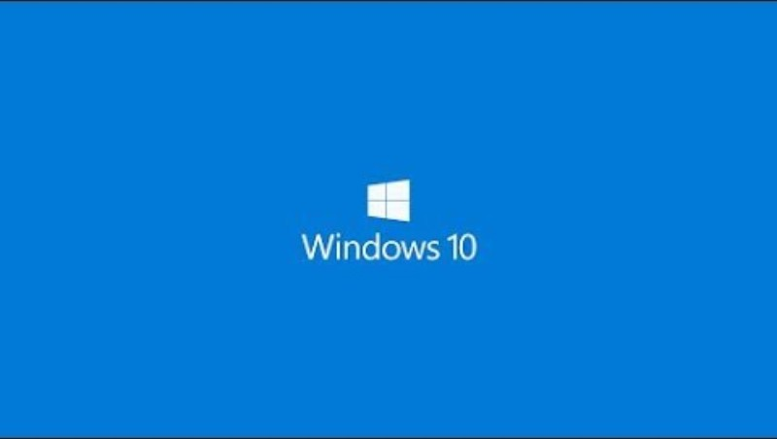
Brain Break
🧍 Stand, stretch, and reset!
Mini challenge: 'Name that beep’
Start the time
Play each sound
First to raise hand answers
Notes:
Start the timer, play the beeps
If this goes quickly, have them search youtube for more codes

Slide 12
09/03/2025 Lesson 2
Lesson Highlights
Lesson 1.6: Cybersecurity Essentials

Slide 13
09/03/2025 End Discussion (5 min)
Wrap-Up Questions
Where do you see CIA (Confidentiality, Integrity, Availability) in daily tech?
Name one AAA control you used today.
One IoT risk at home or school and how to reduce it.

Slide 14
09/04/2025
Description Recognize common cyberattacks and key defenses, then demonstrate understanding on a cybersecurity quiz and reflect on areas to improve. Learning Objectives
Identify and define different types of cyberattacks (malware, viruses, ransomware, spyware, phishing)
Explain the importance of preventative measures like antivirus software, updates, HTTPS, and firewalls
Analyze real-world examples of phishing attacks and develop strategies for identifying suspicious online activities
Prove their knowledge of basic cybersecurity concepts and its impacts through a multiple choice quiz

Slide 15
09/04/2025 Beg. Discussion (8 min)
Discussion Questions
Which personal info is most important to protect?
Top phishing red flags?
First step if you suspect malware?

Slide 16
09/04/2025 Lesson 1 (35 min)
Lesson Highlights
Lesson 1.7: Common Cyber Attacks and Prevention?

Slide 17
09/04/2025 Brain Break (7 min)
Brain Break Trivia (Video Game Theme):
Which company created the PlayStation console? →
Highest-selling video game of all time? →
In The Legend of Zelda, main character’s name? →
Which video game first introduced Mario? →
Sony
Minecraft
Link
Donkey Kong

Slide 18
09/04/2025 Lesson 2 (35 min)
Lesson Highlights
Lesson 1.8: Cybersecurity and You Quiz

Slide 19
09/04/2025 End Discussion (5 min)
Wrap-Up Questions
Strongest quiz topic and why?
One concept to review next.
One strategy you’ll use on the next assessment.

Slide 20

09/05/2025
Description Explore the purpose and history of cryptography and apply symmetric ciphers to encode/decode messages while comparing their trade‑offs. Learning Objectives
Decode messages encrypted with Caesar and Vigenere ciphers
Explain the concept of encryption and its role in secure communication
Identify and compare different historical and modern encryption techniques
Analyze the limitations of certain decryption methods (brute force, letter frequency analysis)
Discuss the potential future applications of cryptography
Explain the characteristics of symmetric algorithms and use them to encode and decode text. Specific ciphers include block, substitution, and transposition ciphers.

Slide 21
09/05/2025 Beg. Discussion (8 min)
Discussion Questions
Why are cryptograms hard to crack?
One strategy to solve a cipher?
Where do you encounter encryption daily?

Slide 22
09/05/2025 Lesson 1 (35 min)
Lesson Highlights
Lesson 2.1: Cryptography: Then Now and Future

Slide 23
09/05/2025 Brain Break (7 min)
Quick Draw Challenge
Draw a robot trying to carry a hard drive
Share a few drawings.

Slide 24
09/05/2025 Lesson 2 (35 min)
Lesson Highlights
Lesson 2.2: Symmetric Encryption

Slide 25
09/05/2025 End Discussion (5 min)
Wrap-Up Questions
One difference between transposition and block ciphers?
When would you choose block vs stream?
How does key length affect security?

Slide 26
09/08/2025
Description Understand asymmetric cryptography and key exchange, then connect concepts to web trust with certificates, TLS, and hashing for integrity. Learning Objectives
Identify the weaknesses with symmetric key encryption and why modern cryptography involves more complex mathematics
Explain the difference between symmetric and asymmetric encryption
Describe the key exchange process using the Diffie-Hellman algorithm (basic understanding)
Explain how public-key cryptography is used for encryption and decryption
Define digital certificates and explain their role in web security
Describe the basic steps involved in the SSL/TLS handshake process

Slide 27
09/08/2025 Beg. Discussion (8 min)
Discussion Questions
Why is Vigenère harder than Caesar?
How do public and private keys differ?
What problem does asymmetric crypto solve?

Slide 28
09/08/2025 Lesson 1 (35 min)
Lesson Highlights
Lesson 2.3: Asymmetric Encryption?

Slide 29
09/08/2025 Brain Break (7 min)
OS Charades —
Prompts:
Open a folder in Windows Explorer
Use Spotlight Search on a Mac
Type commands into a Linux terminal
Restart a computer

Slide 30
09/08/2025 Lesson 2 (35 min)
Lesson Highlights
Lesson 2.4: Authentication Methods

Slide 31
09/08/2025 End Discussion (5 min)
Wrap-Up Questions
Expired vs revoked certificate—Which is riskier and why?
What job does TLS do?
Which MFA method would you recommend and why?

Slide 32
09/09/2025
Description Conclude the cryptography unit with a quiz, then kick off the escape room project by brainstorming puzzles, learning goals, and a cohesive storyline. Learning Objectives
Prove their knowledge of cryptography through a multiple-choice quiz
Demonstrate their understanding of different cryptographic techniques by creating puzzles
Develop a storyline and theme for their escape room, incorporating creativity and problem-solving skills
Collaborate effectively to design and implement their escape room experience
Provide and receive constructive feedback to improve their escape room design

Slide 33
09/09/2025 Beg. Discussion (8 min)
Discussion Questions
Which item tested understanding vs memorization?
One mistake you learned from?

Slide 34
09/09/2025 Lesson 1 (35 min)
Lesson Highlights
Lesson 2.5: Cryptography Quiz?

Slide 35
09/09/2025 Brain Break (7 min)
Story Chain

Slide 36

Brain Break: Story Chain
Students stand in a circle
01
One student starts a sentence about Windows installation
02
Each student adds one line to the story as it moves around the room
03
Goal: Build a silly but memorable story about installing Windows
04

Slide 37
09/09/2025 Lesson 2 (35 min)
Lesson Highlights
Lesson 3.1: Create an Escape Room (1: Brainstorming)

Slide 38
09/09/2025 End Discussion (5 min)
Wrap-Up Questions
What core concept will your puzzle assess?
How will you keep puzzles fun but fair?
How will you provide helpful hints?

Slide 39
09/10/2025
Daily Description Design and develop escape room puzzles, focusing on clarity, difficulty, assets, and early iteration during build time. Learning Objectives
Demonstrate their understanding of different cryptographic techniques by creating puzzles
Develop a storyline and theme for their escape room, incorporating creativity and problem-solving skills
Collaborate effectively to design and implement their escape room experience
Provide and receive constructive feedback to improve their escape room design

Slide 40
09/10/2025 Beg. Discussion (8 min)
Discussion Questions
What makes a puzzle clearly teach its concept?
How will you prevent unintended solutions?
Which rubric criterion are you targeting today?

Slide 41
09/10/2025 Lesson 1 (35 min)
Lesson Highlights
Lesson 3.1: Create an Escape Room (2: Designing Puzzles)

Slide 42
09/10/2025 Brain Break (7 min)
Simon Says: 7 minutes.

Slide 43
09/10/2025 Lesson 2 (35 min)
Lesson Highlights
Lesson 3.1: Create an Escape Room (3: Development)

Slide 44
09/10/2025 End Discussion (5 min)
Wrap-Up Questions
Biggest blocker toand your next step?
One asset or tool you still need?
How will you test difficulty?

Slide 45
09/11/2025
Daily Description Test escape rooms with peer feedback to iterate, then present final designs and reflect on what worked and what to improve. Learning Objectives
Demonstrate their understanding of different cryptographic techniques by creating puzzles
Develop a storyline and theme for their escape room, incorporating creativity and problem-solving skills
Collaborate effectively to design and implement their escape room experience
Provide and receive constructive feedback to improve their escape room design

Slide 46
09/11/2025 Beg. Discussion (8 min)
Discussion Questions
What feedback do you most need from testers?
How will you define “too easy” vs “too hard”?
What is your iteration plan?

Slide 47
09/11/2025 Lesson 1 (35 min)
Lesson Highlights
Lesson 3.1: Create an Escape Room (4: Testing)

Slide 48
09/11/2025 Brain Break (7 min)
Brain Break Activity
Guess the Song: 10-second clips.

Slide 49
09/11/2025 Lesson 2 (35 min)
Lesson Highlights
Lesson 3.1: Create an Escape Room
(5: Presentation/Reflection)

Slide 50
09/11/2025 End Discussion (5 min)
Wrap-Up Questions
What design choice had the biggest impact?
One change if you had another day.
How did your puzzles measure the learning goals?

Slide 51
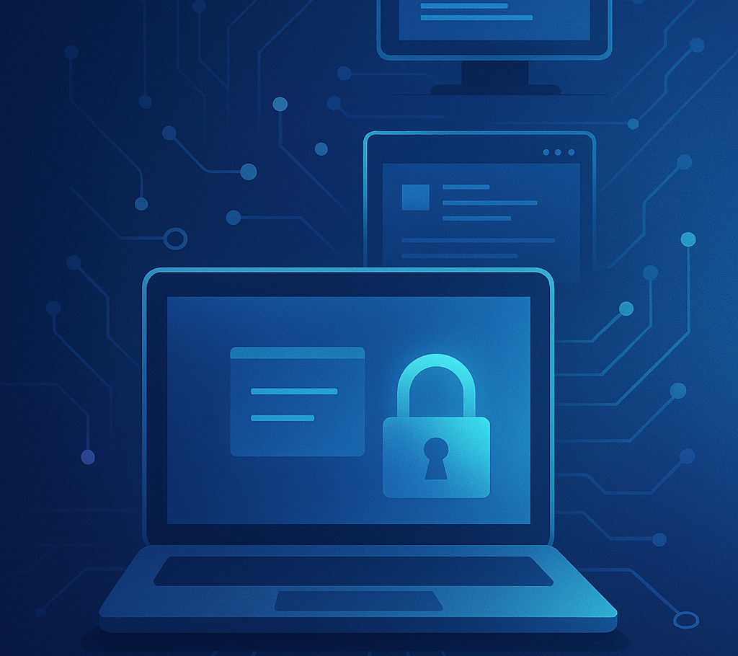
09/12/2025
Daily Description Learn core operating system functions and types, then apply concepts hands‑on by configuring system settings and troubleshooting. Learning Objectives
Explain the purpose of operating systems
Identify the main types of operating systems
Analyze the upgrade and installation process for operating systems
Identify their computer’s operating system
Explore and configure basic display, sound, and storage settings
Troubleshoot minor configuration issues

Slide 52
09/12/2025 Beg. Discussion (8 min)
Discussion Questions
What does an OS do for you?
One trade‑off among Windows, macOS, and Linux?
How can updates improve or hurt your experience?

Slide 53
09/12/2025 Lesson 1 (35 min)
Lesson Highlights
Lesson 4.1: Operating Systems?

Slide 54
09/12/2025 Brain Break (7 min)
Brain Break Activity Pictionary: Rotate drawers.

Slide 55
09/12/2025 Lesson 2 (35 min)
Lesson Highlights Lesson 4.2: Lab: Configuring a Computer

Slide 56
09/12/2025 End Discussion (5 min)
Wrap-Up Questions
Which setting improved usability or security most?
One troubleshooting step that helped today.
What will be on your post-setup checklist?

Slide 57
09/15/2025
Daily Description Compare Windows, macOS, and Linux interfaces and file systems, then examine compatibility topics like CPU architecture and file associations. Learning Objectives
Compare and contrast the interface of Mac, Windows, and Linux operating systems
Explain how operating systems use file systems to manage data
Compare and contrast file systems of different operating systems
Explain the role of the processor in a computer system
Explain the difference between a 32-bit and 64-bit processor and the impact it has on the operating system

Slide 58
09/15/2025 Beg. Discussion (8 min)
Discussion Questions
Which OS fits which user and why?
One key difference among file systems?
How do licensing or cost affect OS choice?

Slide 59
09/15/2025 Lesson 1 (35 min)
Lesson Highlights
Lesson 4.3: Comparing Operating Systems?

Slide 60
09/15/2025 Brain Break (7 min)
Two Truths & a Lie.

Slide 61
09/15/2025 Lesson 2 (35 min)
Lesson Highlights Lesson 4.4: Compatibility

Slide 62
09/15/2025 End Discussion (5 min)
Wrap-Up Questions
32‑bit vs 64‑bit: one impact you’d notice.
One compatibility issue moving files between OSes.
How do default app associations affect workflow?

Slide 63
09/16/2025
Daily Description Differentiate laptops and tablets for real‑world use cases, then evaluate software categories and single vs cross‑platform trade‑offs. Learning Objectives
Identify key differences between laptops and tablets
Analyze the strengths and weaknesses of each device type
Explain the different types of software (productivity, collaboration, business) and the purpose of each.
Explain the benefits and challenges of single and cross-platform software.

Slide 64
09/16/2025 Beg. Discussion (8 min)
Discussion Questions
When is a tablet preferable to a laptop?
Which port or accessory do you rely on most?
How do battery life and thermals affect your choice?

Slide 65
09/16/2025 Lesson 1 (35 min)
Lesson Highlights Lesson 4.5: Laptops and Tablets?

Slide 66
09/16/2025 Brain Break (7 min)
Brain Break Activity Would You Rather (Round 2).

Slide 67
09/16/2025 Lesson 2
(35 min)
Lesson Highlights Lesson 4.6: Software and Applications

Slide 68
09/16/2025 End Discussion (5 min)
Wrap-Up Questions
One app you use daily and its category.
Single‑platform vs cross‑platform—one benefit and one challenge.
System vs application vs utility software—one‑liner each.

Slide 69
09/17/2025
Daily Description Analyze software license models and installation approaches, then apply application security practices such as updates, backups, and least privilege. Learning Objectives
Explain the different types of software licenses
Explain the different delivery methods and architecture models of installing software
Explain the importance of application security
Explain the multiple methods for protecting software

Slide 70
09/17/2025 Beg. Discussion (8 min)
Discussion Questions
Open‑source vs proprietary: one pro and one con.
What obligations can come with OSS licenses?
How can licenses influence product decisions?

Slide 71
09/17/2025 Lesson 1 (35 min)
Lesson Highlights Lesson 4.7: Software Licenses?

Slide 72
09/17/2025 Brain Break (7 min)
Brain Break Activity Mindfulness: 4-4-4 breathing.

Slide 73
09/17/2025 Lesson 2 (35 min)
Lesson Highlights
Lesson 4.8: Application Security

Slide 74
09/17/2025 End Discussion (5 min)
Wrap-Up Questions
One habit that improves application security.
Why keep software updated?
How would least privilege protect you?

Slide 75
09/18/2025
Daily Description Harden browsers for privacy and security, then strengthen system administration through accounts, permissions, baselines, and audits. Learning Objectives
Configure their browser to enhance security and privacy
Explain how the following features impact their browser security: cache, client-side scripting, browser extensions, private browsing, proxy settings, certificates, and popup blockers
Describe appropriate browser security configurations
Describe how creating user accounts and permissions enhances security
Define system hardening and explain the importance of establishing baseline security, including deciding rules around authentication and authorization
Explain the importance of performing security audits

Slide 76
09/18/2025 Beg. Discussion (8 min)
Discussion Questions
Which browser setting most improves privacy?
One extension you trust—and why?
When should you use a separate profile/container?

Slide 77
09/18/2025 Lesson 1 (35 min)
Lesson Highlights
Lesson 4.9: Browser Configuration?

Slide 78
09/18/2025 Brain Break (7 min)
Brain Break Activity Riddle Challenge 2.

Slide 79
09/18/2025 Lesson 2 (35 min)
Lesson Highlights Lesson 4.10: System Administration

Slide 80
09/18/2025 End Discussion (5 min)
Wrap-Up Questions
One task that needs admin rights vs standard user.
What does “system hardening” look like on a school PC?
One log you would check during troubleshooting.

Slide 81
09/19/2025
Daily Description Learn core CLI concepts and safely practice navigation and file operations from the terminal. Learning Objectives
Understand the connection between a command line (CLI) interface and a graphical line interface (GUI)
Use the appropriate command line tool for different tasks
Practice basic navigation commands in the CLI (cd, ls, open..)
Navigate to specific directories on their device
List the contents of a directory
Open files from the CLI.

Slide 82
09/19/2025 Beg. Discussion (8 min)
Discussion Questions
When is the CLI faster than a GUI?
What does “path” mean?
Two safe commands to explore first.

Slide 83
09/19/2025 Lesson 1 (35 min)
Lesson Highlights Lesson 4.11: Command Line Interface?

Slide 84
09/19/2025 Brain Break (7 min)
Trivia 2: Mixed topics.

Slide 85
09/19/2025 Lesson 2 (35 min)
Lesson Highlights
Lesson 4.12: Lab: Navigating with the CLI

Slide 86
09/19/2025 End Discussion (5 min)
Wrap-Up Questions
Which commands did you practice?
How did you verify each step worked?
One precaution to avoid destructive operations.

Slide 87
09/23/2025
Daily Description Demonstrate system administration knowledge on a unit quiz and reflect on strengths, gaps, and next steps. Learning Objectives
Prove their knowledge of system administration concepts and its impacts through a multiple choice quiz

Slide 88
09/23/2025 Beg. Discussion (10 min)
Discussion Questions
One strategy for tricky multiple‑choice items.
Topic you need last‑minute review on.
A real‑world scenario that connects to this unit.

Slide 89
09/23/2025 Lesson 1 (70 min)
Lesson Highlights
Lesson 4.13: System Administration Quiz?

Slide 90
09/23/2025 Brain Break (5 min)
Brain Break Activity Stretch & Breathe: Light stretches.

Slide 91
09/23/2025 End Discussion (5 min)
Wrap-Up Questions
Most difficult question and why.
One takeaway for next unit.
One study strategy you’ll keep using.

